Slide 1

Network Security

Slide 2
Table of Contents
This document contains the following resources:
Traffic Profile
Normal Activity
Malicious Activity

Slide 3
Traffic Profile

Slide 4
Traffic Profile
Our analysis identified the following characteristics of the traffic on the network:
Feature | Value | Description
Top Talkers (IP Addresses) | 172.16.4.205, 166.62.111.64, 10.0.0.201 | Machines that sent the most traffic.
Most Common Protocols | HTTP, UDP, and TCP | Three most common protocols on the network.
# of Unique IP Addresses | 808 IPv4 | Count of observed IP addresses.
Subnets | 10.6.12.0/24, 127.16.4.0/24 10.0.0.0/24 | Observed subnet ranges.
# of Malware Species | june11.dll, invoice.86495.doc | Number of malware binaries identified in traffic.
Notes:
You may have more than 2 subnets.

Slide 5
Behavioral Analysis
Purpose of Traffic on the Network
Users were observed engaging in the following kinds of activity.
“Normal” Activity
Watching YouTube
Reading News Articles
Reading Blogs
Suspicious Activity
Created web server on the corporate network.
Malware downloaded: june11.dll
Phishing: invoice.86495.doc

Slide 6
Normal Activity

Slide 7
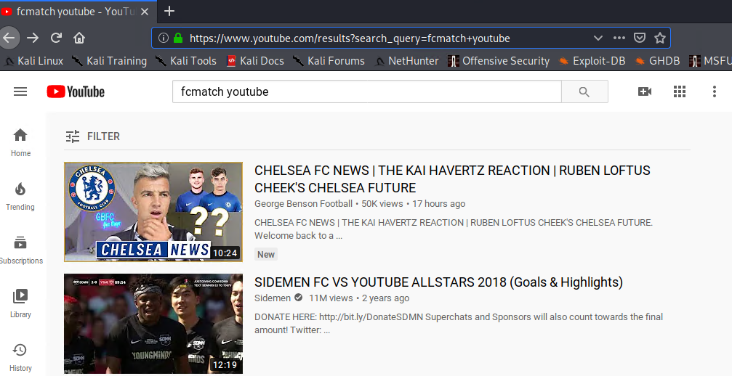
Watching YouTube
Summarize the following:
Traffic/Protocols observed: TCP and HTTP
User was watching soccer videos on YouTube.

Slide 8
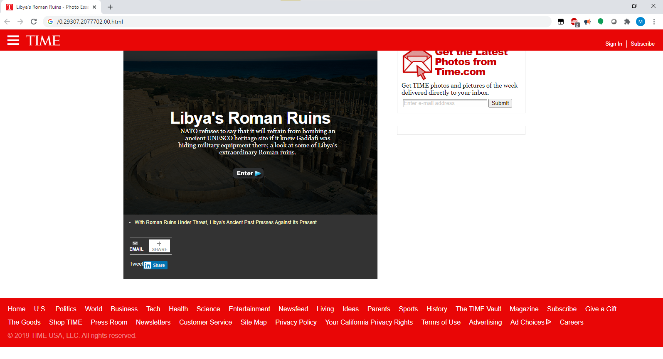
Reading News Articles
Summarize the following:
Traffic/Protocols observed: TCP and HTTP
User was reading articles on time.com.

Slide 9
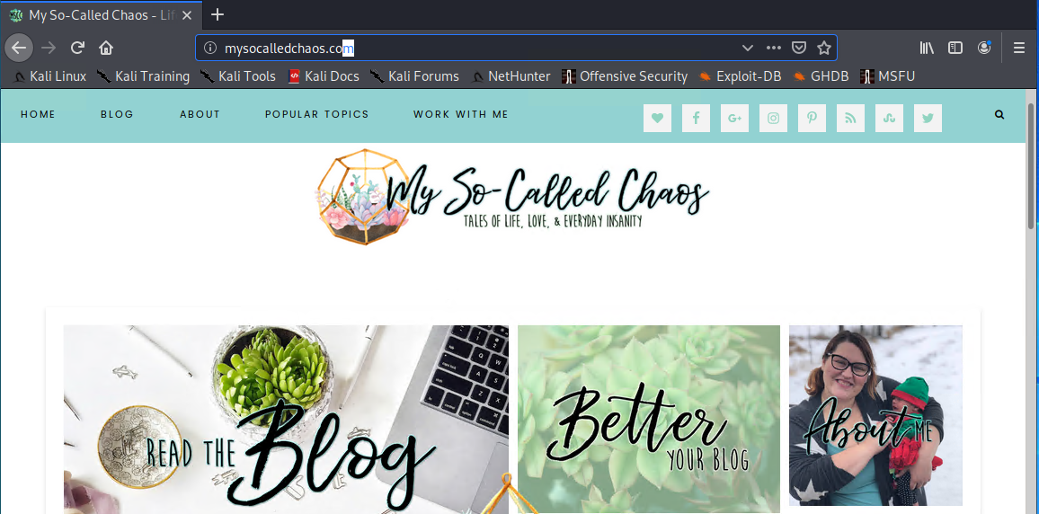
Reading Blogs
Summarize the following:
Traffic/Protocols observed: TCP and HTTP
User was reading articles on mysocalledchaos.com

Slide 10
Malicious Activity

Slide 11
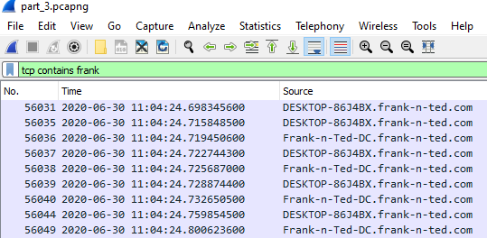
Created Web Server on the Corporate Server
Summarize the following:
Listed as source from corporate packet capture.
frank-in-ted.com: site created on corporate server

Slide 12
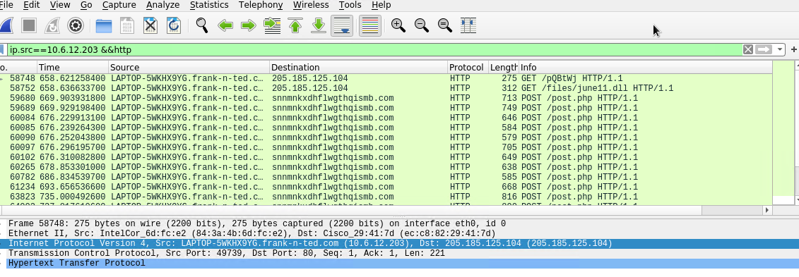
Malware Downloaded: june11.dll
Summarize the following:
Traffic/Protocol observed: HTTP
june11.dll was found.
Used virustotal.com to confirm that it was classified as a trojan.

Slide 13
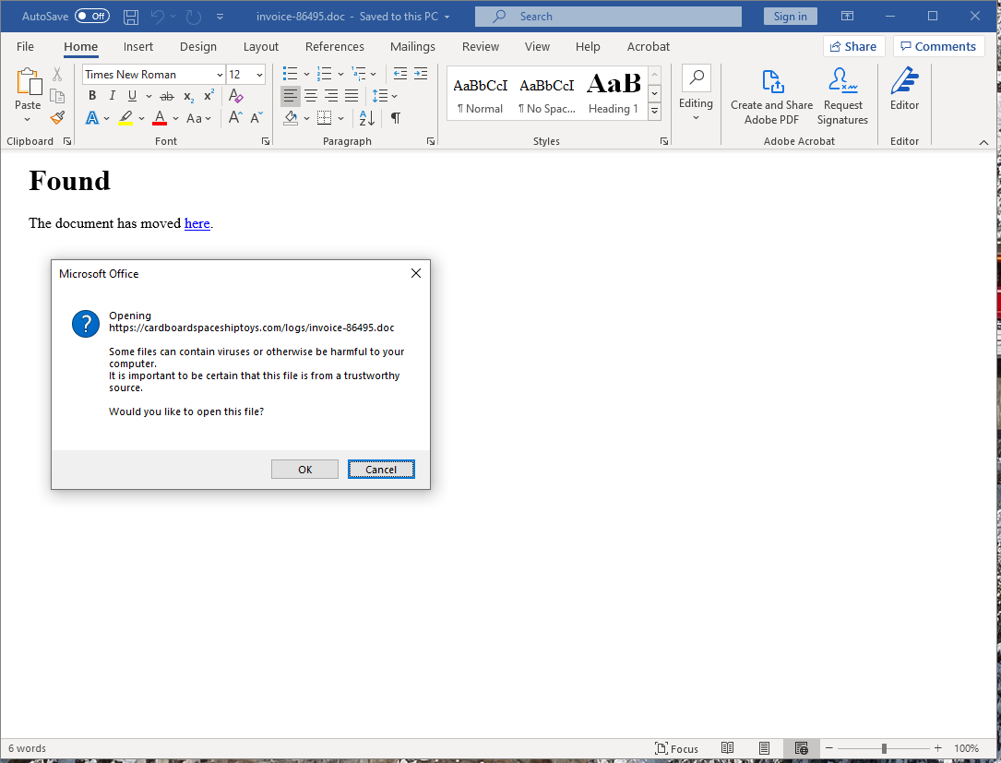
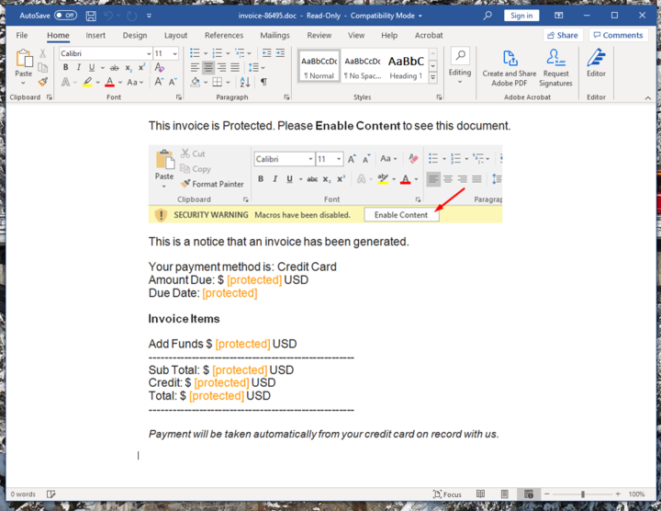
Phishing: invoice.86495.doc
Summarize the following:
Traffic/Protocol observed: HTTP
Potential phishing disguised as invoice from online toy seller.

Slide 14
The End. Any Questions?

